Slide 1
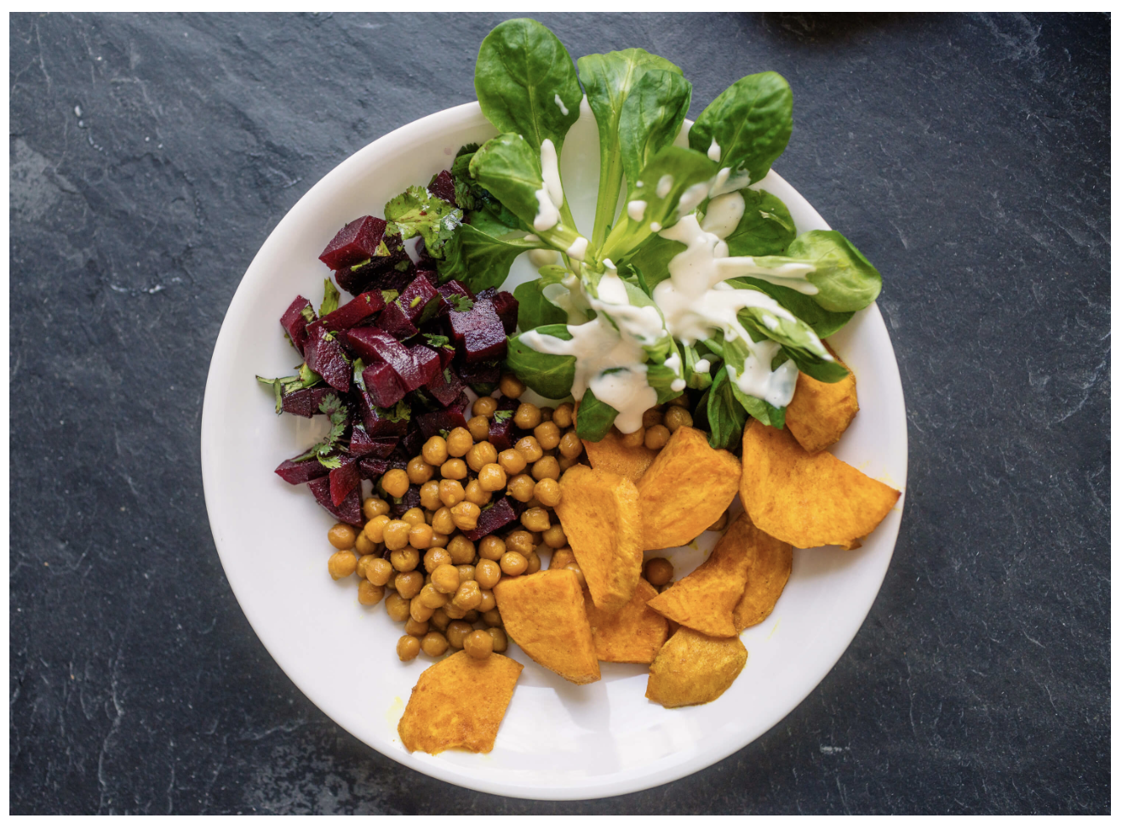
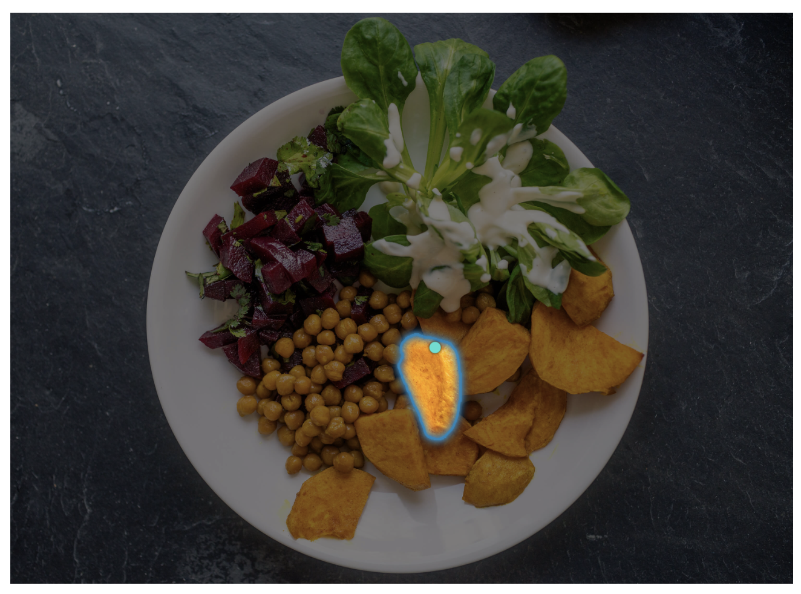
Project Title
Team Name
Alan Blair (zxxxxxxx)
Fatemeh Morgani (zxxxxxxx)
Hao Xue (zxxxxxxx)
Jingying Gao (zxxxxxxx)
Zahra Donyavi (zxxxxxxx)

Slide 2
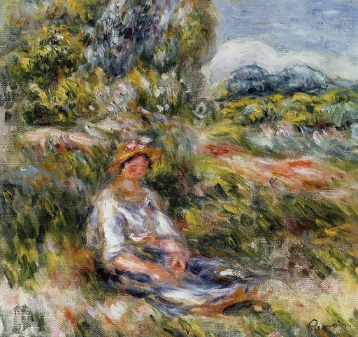
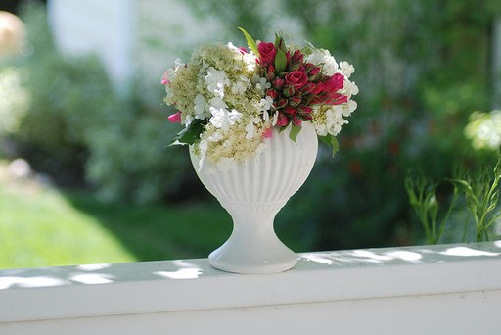
Motivation
Automatic stylisation supports artistic exploration, design and media editing.
Transfer colours, textures and brushstrokes while preserving recognisable objects and scene layout. [1–3]
Compare simple statistical conditioning with richer feature modelling to assess quality and inference cost. [1–3]
Content photograph
Style reference
COCO 2014
WikiArt
Example inputs from the project subset
Presenter: [Name] ([zID])
Notes:
Literature sources: [1] Huang and Belongie, ICCV 2017, Sections 5–8; [2] Xu et al., ICCV 2021, Sections 3–4; [3] Deng et al., CVPR 2022, Sections 1, 3–4. Full references and official URLs are on the References slide.
Project context: https://github.com/Harukadesune/Image_style_transfer/tree/65971e51bf7d586ec322f565060f41f4faf4852a
Example images are inputs, not generated results. Image sources in the repository: data/coco/train2014/COCO_train2014_000000000030.jpg and data/wikiart/Impressionism/wikiart_000003.jpg; both appear in data/subset_manifest.csv. The images illustrate content and style domains, without asserting a transfer result or paired ground truth.

Slide 3
Problem Statement
Given a content photograph and an unpaired reference painting, generate an image that preserves scene structure while adopting the reference style.
Target unseen reference styles and diverse image content, rather than relying on a fixed artistic filter. [1, 3]
Balance local detail, global consistency and inference cost. Perceptual losses are useful proxies, but visual quality also requires inspection. [1–3]
Study the repository’s VGG–AdaIN prototype, custom dual-encoder CNN and StyTr² using common held-out pairs and comparable inference settings.
Presenter: [Name] ([zID])
Notes:
Problem formulation draws on the three reviewed papers and Requirement.md. References [1]–[3] and official URLs are on the References slide.
Repository inspected at main commit 65971e51bf7d586ec322f565060f41f4faf4852a. The three distinguishable code designs are the fixed-VGG AdaIN prototype in 自学.ipynb, the custom dual-encoder CNN with AdaIN/RGB-statistic conditioning in gp_completed.ipynb, and the StyTr² comparison implementation in StyTr2/StyTr2.ipynb. gp.ipynb is an earlier incomplete custom-CNN notebook. DRB-GAN is a literature reference, not an implementation found in this checkout. IEContraAST is mentioned in the StyTr² notebook but its implementation is absent.
Common held-out pairs and comparable inference settings are evaluation targets, not a claim that current notebook outputs already constitute a controlled benchmark. The notebooks reference different preprocessing/subset arrangements. Local data contains COCO content images and WikiArt paintings, sampled as unpaired domains.

Slide 4
Literature Review: AdaIN
Huang and Belongie (ICCV 2017) enable arbitrary style transfer with a fixed VGG-19 encoder, an AdaIN layer and a trained decoder. [1]
AdaIN matches the channel-wise mean and standard deviation of content features to a style reference, including styles unseen during training.
Content and style losses train the decoder without a discriminator. Feed-forward inference supports fast stylisation and style-strength control.
Limitation: basic feature statistics miss richer correlations. The paper reports a quality trade-off relative to slower optimisation and some single-style models.
Presenter: [Name] ([zID])
Notes:
Source [1]: Huang and Belongie, ICCV 2017, Sections 5–8. https://openaccess.thecvf.com/content_iccv_2017/html/Huang_Arbitrary_Style_Transfer_ICCV_2017_paper.html
The encoder is fixed. The decoder is trained with content and style losses, without adversarial training. All reported capabilities and limitations refer to the authors’ model, not results from this course project.

Slide 5
Literature Review: DRB-GAN
Xu et al. (ICCV 2021) combine arbitrary and collection style transfer. Collection transfer aggregates style codes from several paintings. [2]
A style encoder predicts dynamic convolution weights and AdaIN affine parameters for the generator's Dynamic ResBlocks.
A collection-conditioned discriminator and adversarial, perceptual and style classification losses guide training. The authors report improved style recognition and user preference.
Implementation trade-off: collection labels and multiple trainable components increase data preparation and integration demands.
Presenter: [Name] ([zID])
Notes:
Source [2]: Xu et al., ICCV 2021, Sections 3–4. https://openaccess.thecvf.com/content/ICCV2021/html/Xu_DRB-GAN_A_Dynamic_ResBlock_Generative_Adversarial_Network_for_Artistic_Style_ICCV_2021_paper.html
The authors report style recognition and user preference results. The final bullet is our review assessment of architecture and integration demands. It is not an author-measured failure or an experiment from this course project.

Slide 6
Literature Review: StyTr²
Deng et al. (CVPR 2022) use separate content/style Transformer encoders and a Transformer decoder to model long-range dependencies. [3]
Content-aware positional encoding (CAPE) supports changes in image scale. A CNN decoder reconstructs the output, trained with perceptual and identity losses.
On the authors' 800-image benchmark, content loss is 1.91 versus AdaIN's 2.34. These values are perceptual proxies. [3, Table 2]
Trade-off: 512 × 512 inference takes 0.661 s versus AdaIN’s 0.008 s on one Tesla P100. [3, Table 1]
Presenter: [Name] ([zID])
Notes:
Source [3]: Deng et al., CVPR 2022, Sections 3–4 and Tables 1–2. https://openaccess.thecvf.com/content/CVPR2022/html/Deng_StyTr2_Image_Style_Transfer_With_Transformers_CVPR_2022_paper.html
The authors evaluate 40 style images × 20 content images = 800 stylised outputs. Table 2 reports content loss 1.91 for StyTr² and 2.34 for AdaIN. Table 1 reports 512 × 512 inference time on one Tesla P100: 0.661 s for StyTr² and 0.008 s for AdaIN. These are author-reported results and perceptual proxies, not measurements from this course project.

Slide 7
Dataset(s)
Provide details about the dataset or the RL tasks
Presenter: Hao Xue (zxxxxxxx)

Slide 8
Data Analysis
Briefly provide details here …
Presenter: Hao Xue (zxxxxxxx)

Slide 9
Method(s)
Details here …
Presenter: Jingying Gao (zxxxxxxx)

Slide 10
Results
Details here …
Presenter: Zahra Donyavi (zxxxxxxx)

Slide 11
Discussion
Details here …
Presenter: Zahra Donyavi (zxxxxxxx)

Slide 12
Conclusion
Write here
Presenter: Zahra Donyavi (zxxxxxxx)

Slide 13
References
[1] X. Huang and S. Belongie, “Arbitrary style transfer in real-time with adaptive instance normalization,” in Proc. IEEE International Conference on Computer Vision (ICCV), 2017, pp. 1501–1510.
[2] W. Xu, C. Long, R. Wang, and G. Wang, “DRB-GAN: A dynamic ResBlock generative adversarial network for artistic style transfer,” in Proc. IEEE/CVF International Conference on Computer Vision (ICCV), 2021, pp. 6383–6392.
[3] Y. Deng, F. Tang, W. Dong, C. Ma, X. Pan, L. Wang, and C. Xu, “StyTr²: Image style transfer with transformers,” in Proc. IEEE/CVF Conference on Computer Vision and Pattern Recognition (CVPR), 2022, pp. 11326–11336.
Presenter: [Name] ([zID])
Notes:
[1] X. Huang and S. Belongie, “Arbitrary style transfer in real-time with adaptive instance normalization,” in Proc. IEEE International Conference on Computer Vision (ICCV), 2017, pp. 1501–1510.
https://openaccess.thecvf.com/content_iccv_2017/html/Huang_Arbitrary_Style_Transfer_ICCV_2017_paper.html
[2] W. Xu, C. Long, R. Wang, and G. Wang, “DRB-GAN: A dynamic ResBlock generative adversarial network for artistic style transfer,” in Proc. IEEE/CVF International Conference on Computer Vision (ICCV), 2021, pp. 6383–6392.
https://openaccess.thecvf.com/content/ICCV2021/html/Xu_DRB-GAN_A_Dynamic_ResBlock_Generative_Adversarial_Network_for_Artistic_Style_ICCV_2021_paper.html
[3] Y. Deng, F. Tang, W. Dong, C. Ma, X. Pan, L. Wang, and C. Xu, “StyTr²: Image style transfer with transformers,” in Proc. IEEE/CVF Conference on Computer Vision and Pattern Recognition (CVPR), 2022, pp. 11326–11336.
https://openaccess.thecvf.com/content/CVPR2022/html/Deng_StyTr2_Image_Style_Transfer_With_Transformers_CVPR_2022_paper.html

Slide 14

This Photo by Unknown Author is licensed under CC BY-SA

